Slide 1
Motivation: From Concepts to Applications

Slide 2
Job Characteristics Model (JCM)
Any job can be described in terms of 5 core job dimensions
Skill variety : various activities
Task identity: completion of whole work
Task significance: substantial impact on others
Autonomy: freedom
Feedback: see how you are doing

Slide 3
Job Characteristics Model (JCM)
Any job can be described in terms of 5 core job dimensions
Skill variety
Task identity
Task significance
Autonomy
Feedback
Relevant Theories

Slide 4
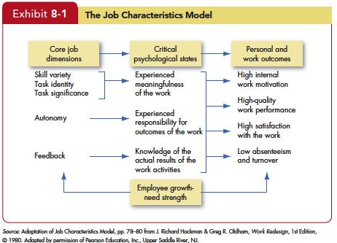

Slide 5
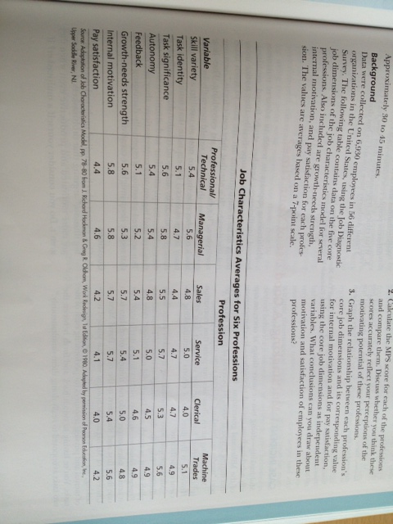
Motivating Potential Score (MPS)
(Skill Variety + Task identity + Task significance)/3 x Autonomy x Feedback
MPS for Managerial = (5.6+4.7+5.8)/3 x 5.4 x 5.2 = 150.696
MPS for Service = (5.0+4.7+5.7)/3 x 5.0 x 5.1 = 130.9
MPS for Clerical = (4.0+4.7+5.3)/3 x 4.5 x 4.6 = 96.6

Slide 6
Motivating by Job Design
Job design
They way the elements in a job are organized

Slide 7
How can jobs be redesigned?
Skill variety
Task identity
Task significance
Autonomy
Feedback

Slide 8
How can jobs be redesigned?
job enrichment
Expansion of jobs

Slide 9
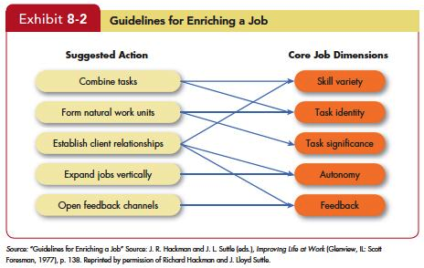

Slide 10
How can jobs be redesigned?
Job rotation
Shifting of an employee from one task to another

Slide 11
Job Rotation
Skill variety
Task identity
Task significance
Autonomy
Feedback
Job Rotation

Slide 12
Relational job design
Make jobs more pro-socially motivating
Connect employees with the beneficiaries of their work

Slide 13
Alternative Work Arrangements
Flextime
Job Sharing
Telecommuting

Slide 14
Alternative Work Arrangements
Flextime
Advantages
Limitation

Slide 15
Alternative Work Arrangements
Job Sharing
Advantages:
Limitation:

Slide 16
Alternative Work Arrangements
Telecommuting
Advantages
Limitation

Slide 17
Employee Involvement
participative process that uses employees’ input to increase their commitment to the organization’s success

Slide 18
Employee Involvement
Skill variety
Task identity
Task significance
Autonomy
Feedback
Employee Involvement

Slide 19
Employee Involvement
Participative Management:
Joint decision-making
Condition
Competence, knowledge, trust, confidence

Slide 20
Employee Involvement
Representative Participation
Redistribution of power
Symbolic effects
Examples
Works councils
Board representatives

Slide 21
Intrinsic rewards
Employee recognition programs
Important work rewards can be both intrinsic and extrinsic
Employee recognition programs vs. compensation systems

Slide 22
Implications for managers
Recognize individual differences.
Spend the time necessary to understand what’s important to each employee.
Design jobs to align with individual needs and maximize their motivation potential.
Use goals and feedback.
You should give employees firm, specific goals, and they should get feedback on how well they are faring in pursuit of those goals.

Slide 23
Implications for managers
Allow employees to participate in decisions that affect them.
Employees can contribute to setting work goals, choosing their own benefits packages, and solving productivity and quality problems.
Recognize the importance of intrinsic motivation

